Slide 1
PM REVIEW
G7T3
Ethan Yang, Kwon Soo Yeon, Nanda Gian,
Qi Haodi, Yanrui Sia

Slide 2
TABLE OF CONTENTS
01
03
Functionalities
Bug Metrics
02
04
Schedule
Roles & Responsibility

Slide 3
FUNCTIONALITIES
Do you plan to drop/add any functionalities?
Do you plan to use any PHP frameworks?
No
No

Slide 4
FUNCTIONALITIES
3) Did you manage to finish login + 1 functionality?
What functionalities have you finished?
Login, Authentication, Protect, Bootstrap, Bid Section
What is the admin password for your cloud deployment?
DeductYourEdollar100!!!
IP address: 3.15.234.42
Yes

Slide 5
SCHEDULE
ITERATION 1
ITERATION 3
INTRODUCTION
TO SPM
FINAL PRESENTATION
ITERATION 2
ITERATION 4
Week 5 & 6
Week 9 & 10
Week 7 & 8
Week 11

Slide 6
ITERATION 1 (16/09/19 - 29/09/19)
WEEK 5:
Back-end
SQL script for creating table and inserting data
Functionalities
Login
Authentication
Protect
WEEK 6:
Back-end
Validation
Functionalities
Bid section
Bootstrap (both UI & JSON)

Slide 7
ITERATION 2 (30/09/19 - 13/10/19)
WEEK 7:
Functionalities
Update bid
Drop bid
Dump tables (web service)
WEEK 8:
Functionalities
Drop section
Start and stop round 1

Slide 8
ITERATION 3 (14/10/19 - 27/10/19)
WEEK 9:
Functionalities
Start and stop round 2
WEEK 10:
Improve functionalities

Slide 9
ITERATION 4 (28/10/19 - 10/11/19)
WEEK 11:
Final debugging
any use cases that we did not cover

Slide 10
MILESTONES
PM Review
Application Demo and Progress Update
UAT
Final Presentation

Slide 11
BUFFER TIME
Every Sunday for all iterations

Slide 12
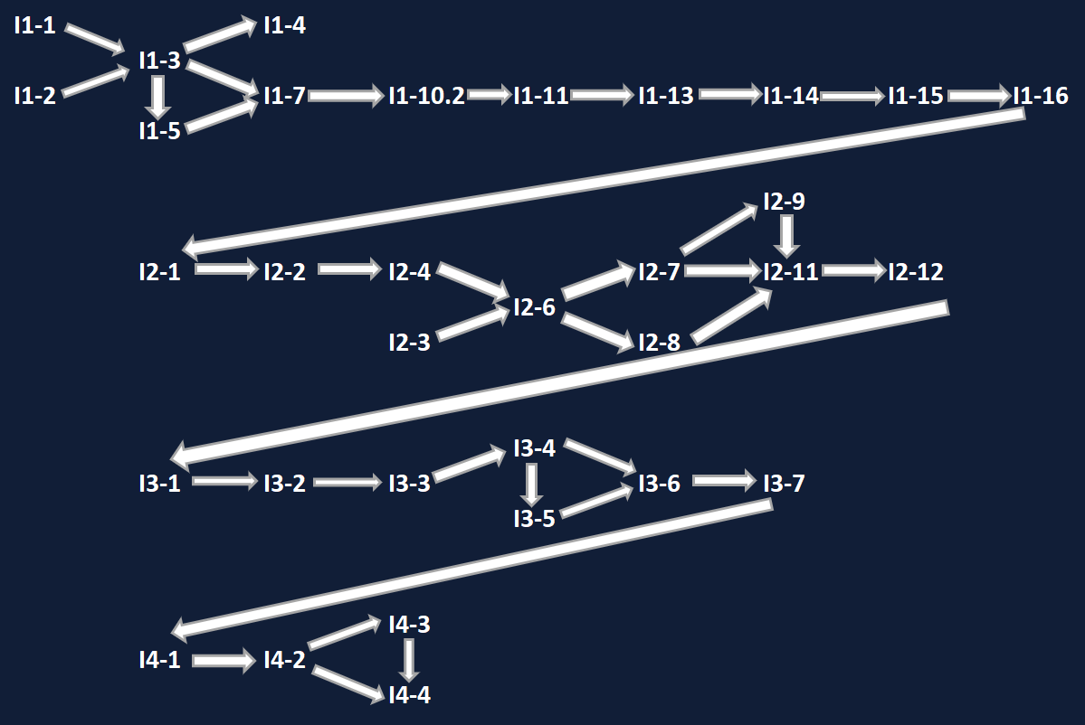
CRITICAL PATH

Slide 13
Bug Metrics
currently have 14 identified bugs
most bugs are found during testing sessions
bugs are fixed on the spot

Slide 14
ROLES & RESPONSIBILITIES
ITERATION 4
ITERATION 3
ITERATION 2
ITERATION 1
PM: YANRUI
CODERS:
ETHAN & SOOYEON
NANDA & HAODI
PM: ETHAN
CODERS:
NANDA & YANRUI
SOOYEON & HAODI
PM: NANDA
CODERS:
SOOYEON & YANRUI
ETHAN & HAODI
PM: SOOYEON
CODERS:
ETHAN & YANRUI
NANDA & HAODI

Slide 15
THANK YOU

